Slide 1
Docker DEEP Dive Updated 5 December 2019

Slide 2
Docker > Agenda
Big picture
Containers
Networking
Q&A
Development
Orchestration
Volumes

Slide 3
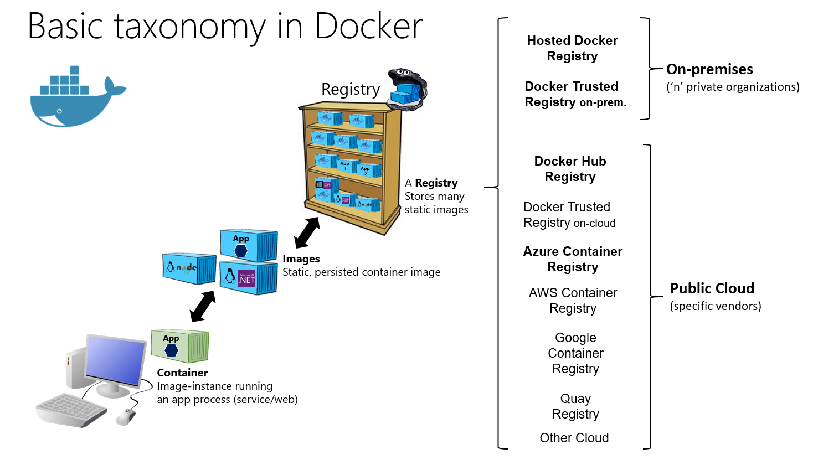
Docker > Taxonomy

Slide 4
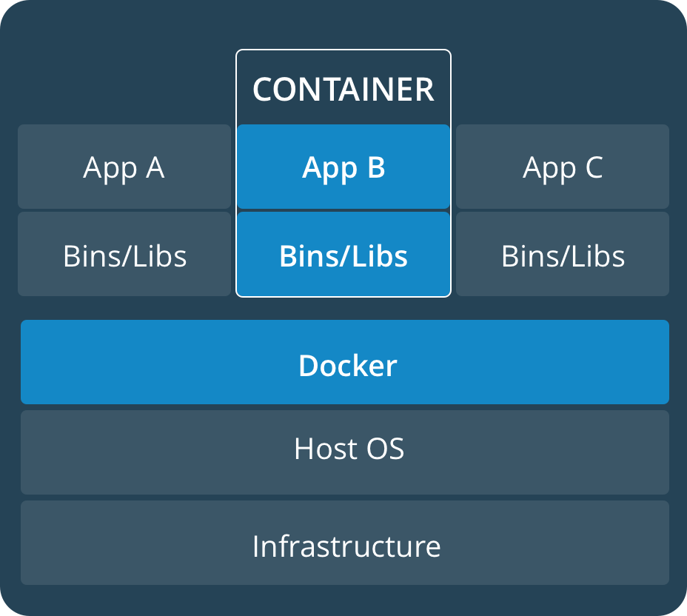
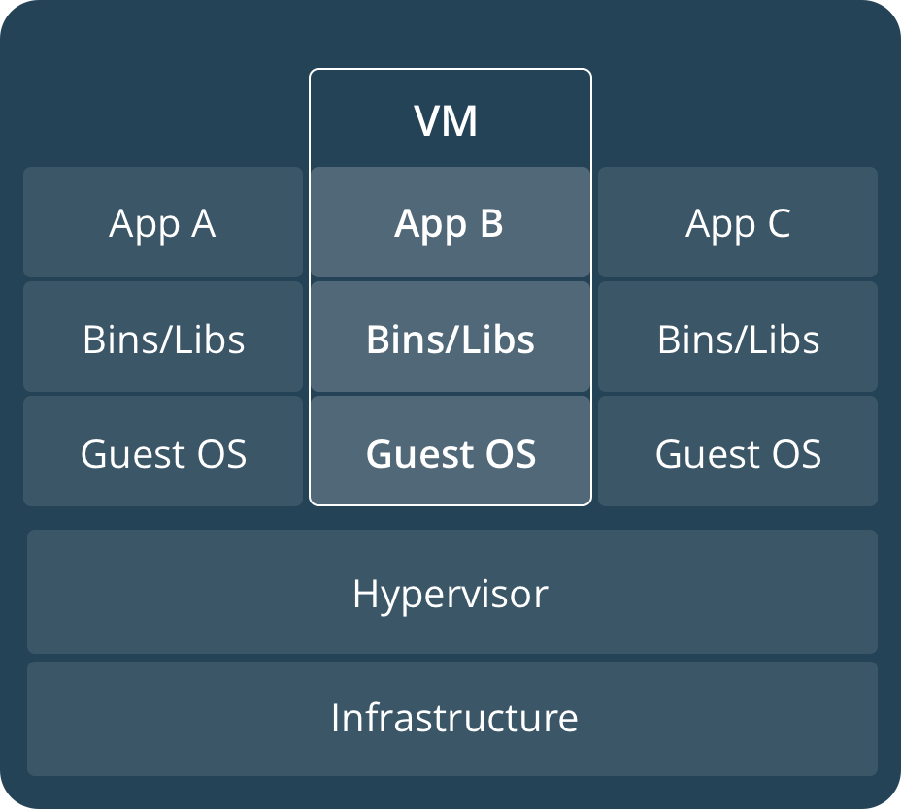
Docker > Big Picture

Slide 5
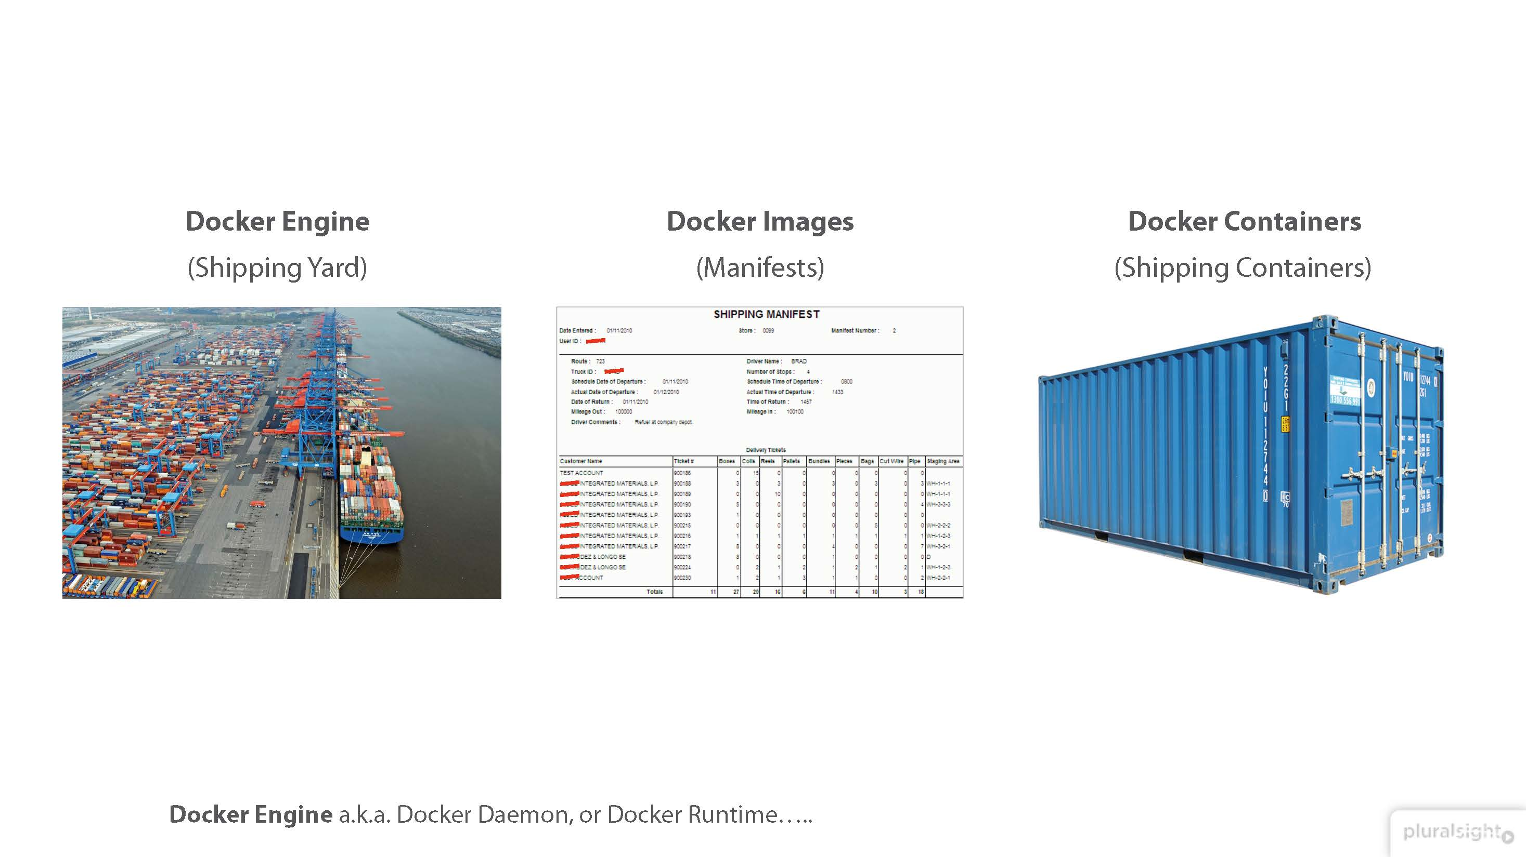
Docker > Basics

Slide 6
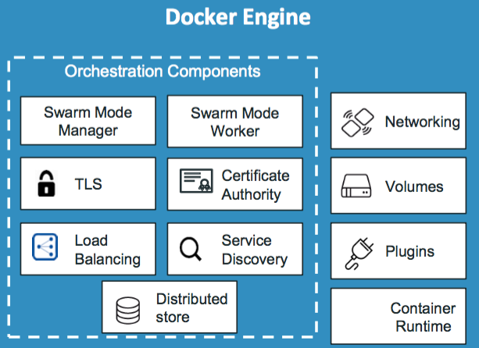
Docker > Engine

Slide 7

Docker > Engine > Demo

Slide 8
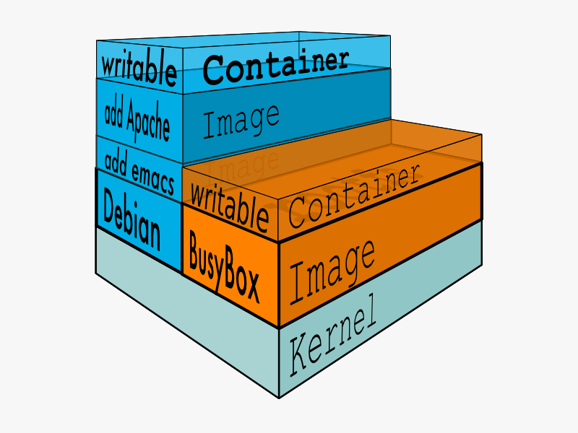
Docker > Images
A container image is a lightweight, stand-alone, executable software package that includes everything needed to run it: code, runtime, system tools, system libraries, settings.
Available for both Linux and Windows based apps, containerized software will always run the same, regardless of the environment.
Images is hosted in registries either locally on your docker daemon or at a remote location. (e.g. https://dtr.orsted.dk)
Docker images have intermediate layers that increase reusability, decrease disk usage, and speed up docker build by allowing each step to be cached. These intermediate layers are not shown by default.

Slide 9
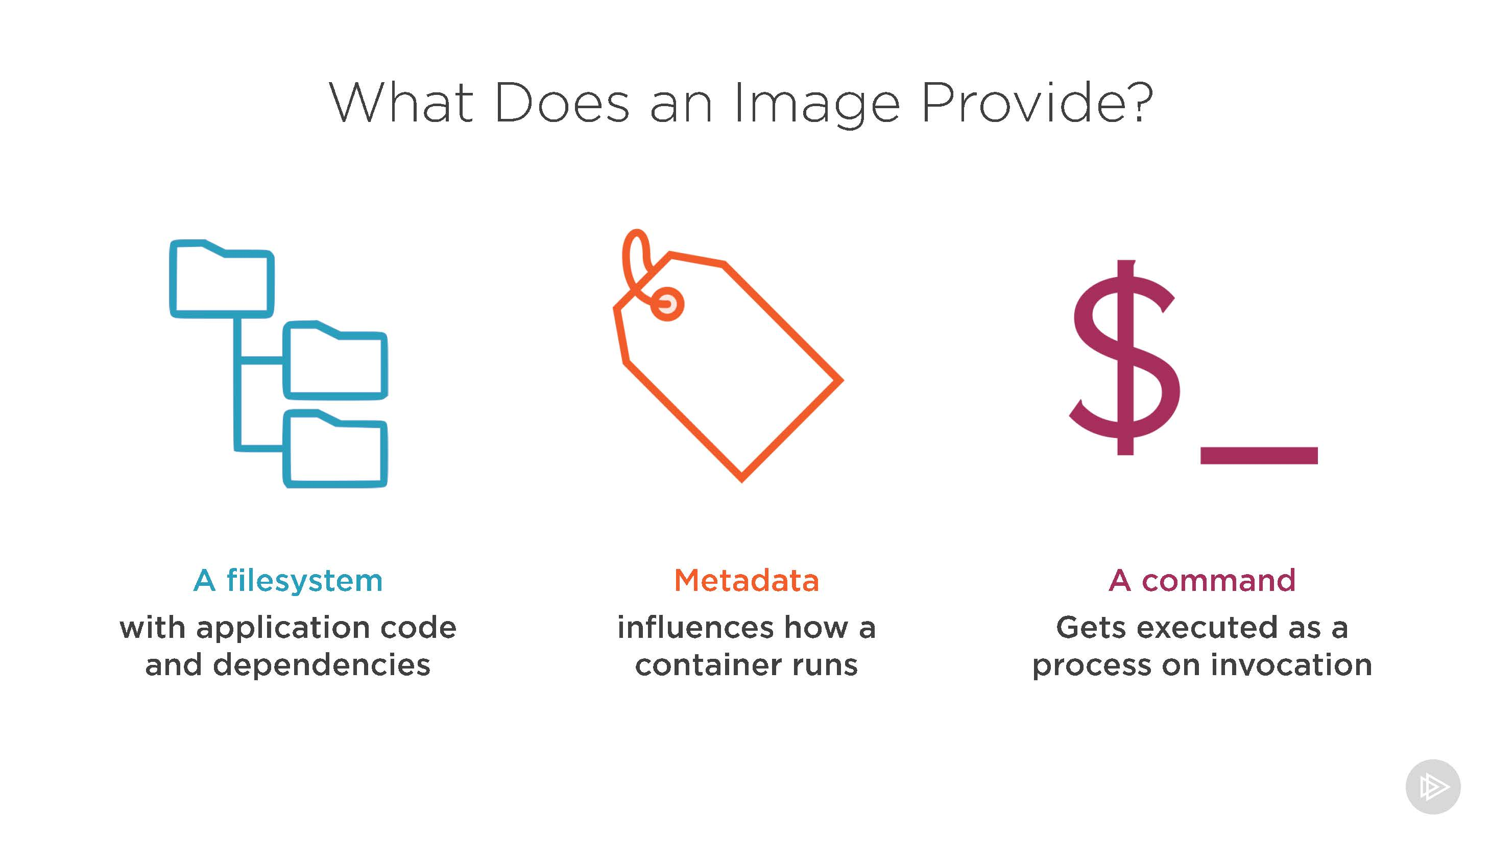
Docker > Images

Slide 10

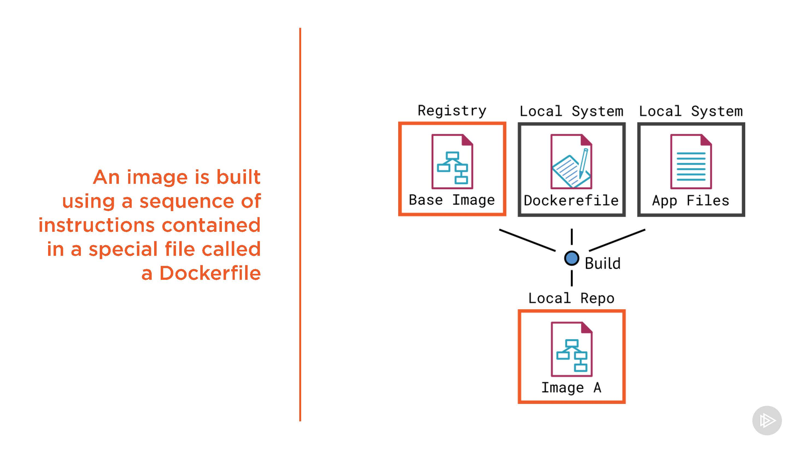
Docker > Images

Slide 11
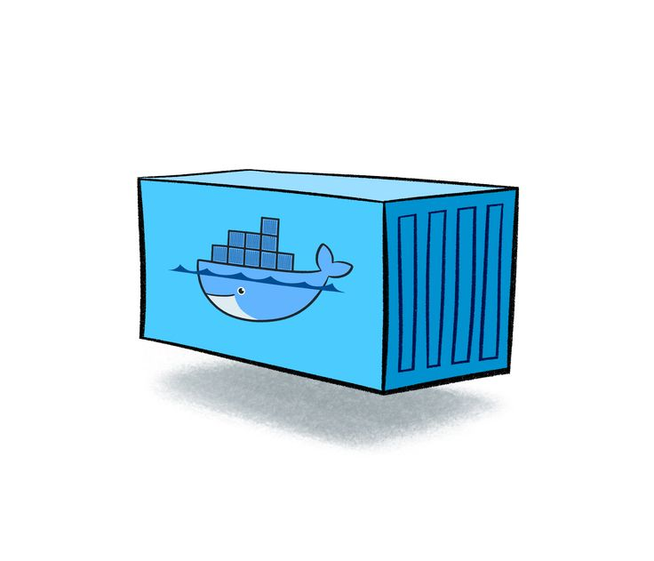
Docker > Containers
Containers are an abstraction at the app layer that packages code and dependencies together.
Multiple containers can run on the same machine and share the OS kernel with other containers, each running as isolated processes in user space.
Containers take up less space than VMs (container images are typically tens of MBs in size) and start almost instantly.
Applications are safer in containers and Docker provides the strongest default isolation capabilities in the industry.

Slide 12
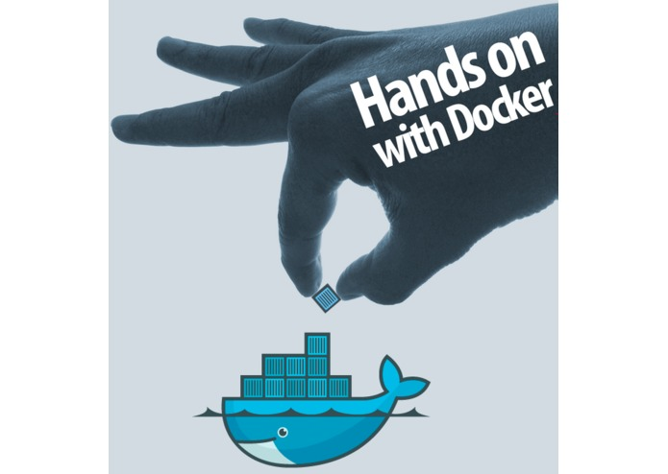
Docker > Containers > Hands-on

Slide 13
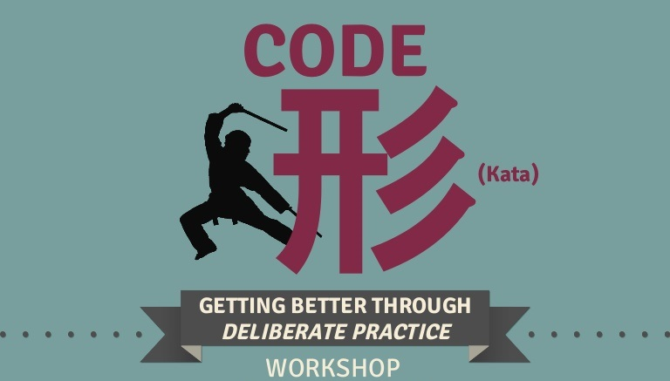
Docker > Containers > Code Kata #1

Slide 14
Docker > Containers > Code Kata #2

Slide 15
Docker > Containers > Code Kata #3

Slide 16
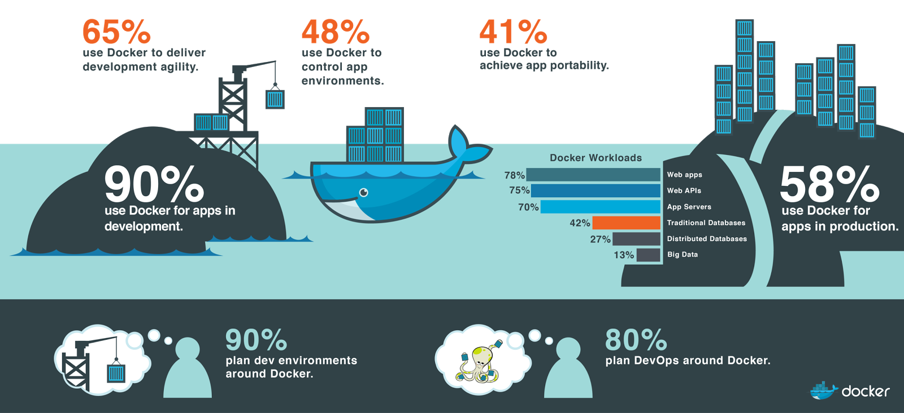
Docker > Containers > Benefits
Provides process isolation.
Enables software defined networking.
Assists CI/CD workflows.
Standardized development environments.
Allow better mimicry of target platform.
Affords increased developer productivity.
Facilitates safe experimentation.
Supports microservice architecture.
Reduce impact of service upgrades.
Enable independently scalable services.
Minimize failure risk.
Allow technological agnosticism.

Slide 17

Docker > Containers > Q/A

Slide 18
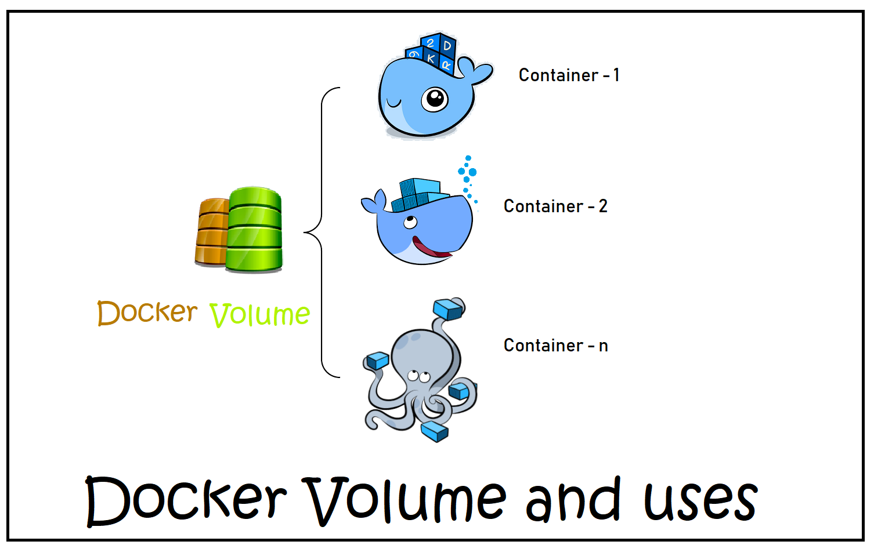
Docker > Volumes

Slide 19
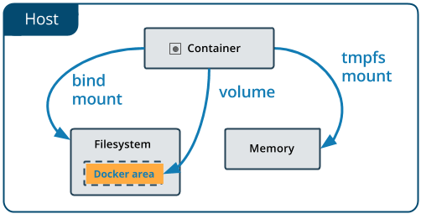
Docker > Volumes
Volumes are stored in a part of the host filesystem which is managed by Docker (/var/lib/docker/volumes/ on Linux). Non-Docker processes should not modify this part of the filesystem. Volumes are the best way to persist data in Docker.
Bind mounts may be stored anywhere on the host system. They may even be important system files or directories. Non-Docker processes on the Docker host or a Docker container can modify them at any time.
tmpfs mounts are stored in the host system’s memory only, and are never written to the host system’s filesystem.

Slide 20
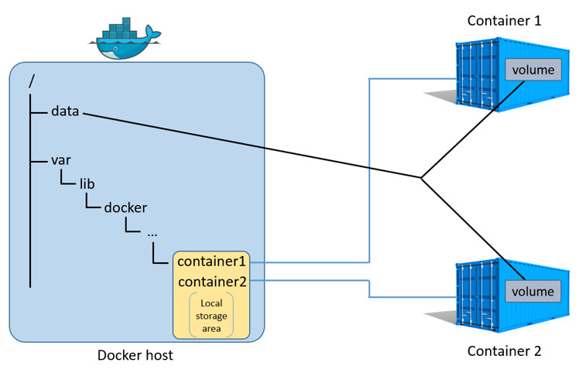
Docker > Volumes > Use cases for volumes
Sharing data among multiple running containers. If you don’t explicitly create it, a volume is created the first time it is mounted into a container. When that container stops or is removed, the volume still exists. Multiple containers can mount the same volume simultaneously, either read-write or read-only. Volumes are only removed when you explicitly remove them.
When the Docker host is not guaranteed to have a given directory or file structure. Volumes help you decouple the configuration of the Docker host from the container runtime.
When you want to store your container’s data on a remote host or a cloud provider, rather than locally.
When you need to back up, restore, or migrate data from one Docker host to another, volumes are a better choice. You can stop containers using the volume, then back up the volume’s directory (such as /var/lib/docker/volumes/<volume-name>).

Slide 21
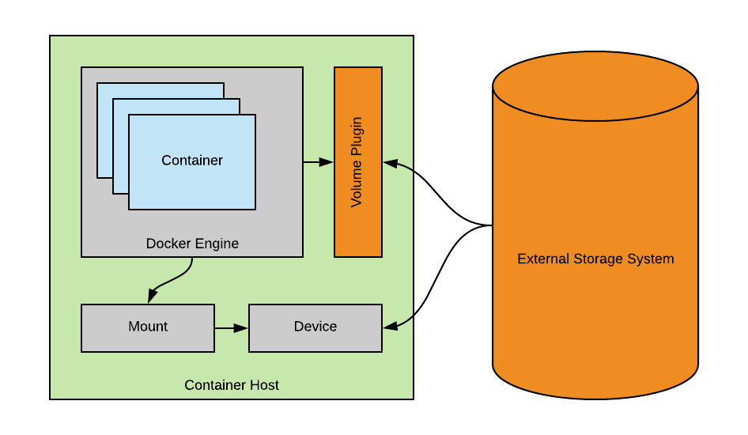
Docker > Volumes > Use cases for mounts
Sharing configuration files from the host machine to containers. This is how Docker provides DNS resolution to containers by default, by mounting /etc/resolv.conf from the host machine into each container.
Sharing source code or build artifacts between a development environment on the Docker host and a container. For instance, you may mount a Maven target/ directory into a container, and each time you build the Maven project on the Docker host, the container gets access to the rebuilt artifacts.
If you use Docker for development this way, your production Dockerfile would copy the production-ready artifacts directly into the image, rather than relying on a bind mount.
When the file or directory structure of the Docker host is guaranteed to be consistent with the bind mounts the containers require.

Slide 22
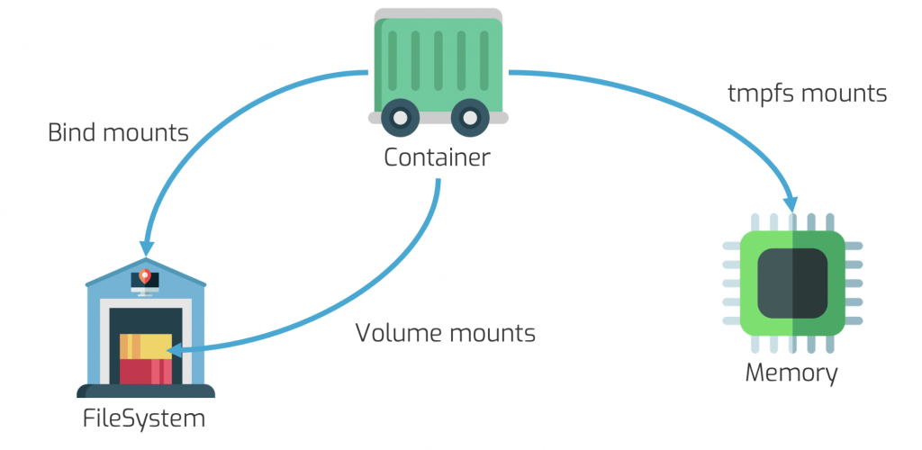
Docker > Volumes > Use cases for tmpfs
tmpfs mounts are best used for cases when you do not want the data to persist either on the host machine or within the container. This may be for security reasons or to protect the performance of the container when your application needs to write a large volume of non-persistent state data.

Slide 23
Docker > Volumes > Hands-on

Slide 24
Docker > Volumes > Code Kata #4

Slide 25
Docker > Volumes > Q/A

Slide 26
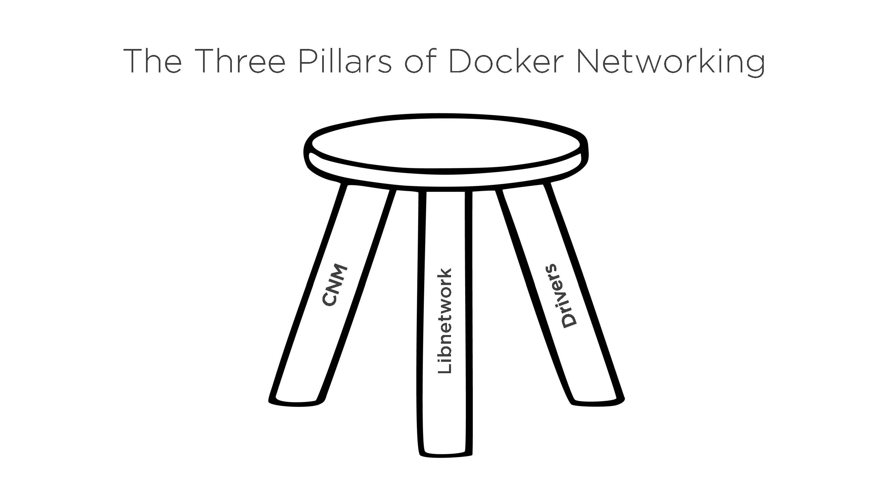
Docker > Networking

Slide 27
Docker > Networking > Taxonomy
An overlay network is a computer network that is built on top of another network.
Software-defined networking (SDN) technology is an approach to cloud computing that facilitates network management and enables programmatically efficient network configuration in order to improve network performance and monitoring.
Orchestration is the automated configuration, coordination, and management of computer systems and software.
A media access control address (MAC address) of a device is a unique identifier assigned to a network interface controller (NIC) for communications at the data link layer of a network segment.
IP, Short for Internet Protocol, is an address of a computer or other network device on a network using IP or TCP/IP.
The Domain Name System (DNS) is a hierarchical and decentralized naming system for computers, services, or other resources connected to the Internet or a private network.
Virtual Extensible LAN (VXLAN) is a network virtualization technology that attempts to address the scalability problems associated with large cloud computing deployments.
The Container Network Model (CNM) is a specification proposed by Docker, adopted by projects such as libnetwork, with integrations from projects and companies such as Cisco Contiv, Kuryr, Open Virtual Networking (OVN), Project Calico, VMware and Weave.
The Container Network Interface (CNI) is a container networking specification proposed by CoreOS and adopted by projects such as Apache Mesos, Cloud Foundry, Kubernetes, Kurma and rkt. There are also plugins created by projects such as Contiv Networking, Project Calico and Weave.

Slide 28
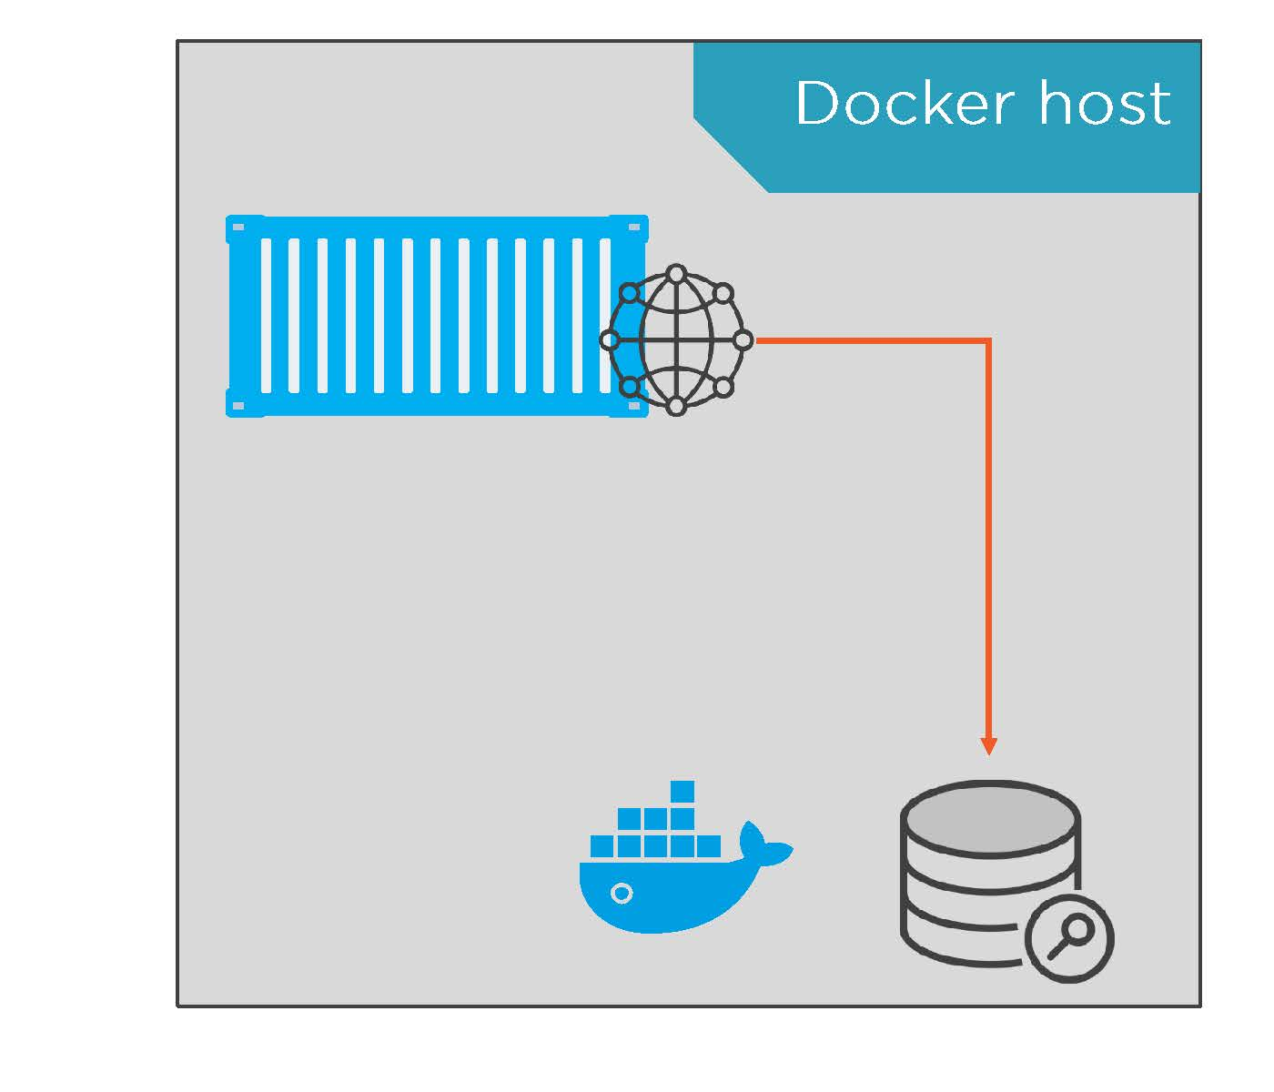
Docker > Networking > DNS
Service discovery is automatic in Docker:
For services.
For containers created with –name or –alias.
Every container gets their own DNS resolver:
Listens on 127.0.0.11:53.
Forwards requests to DNS server on local Docker host.
Network-scoped.

Slide 29
Docker > Networking > Demo

Slide 30
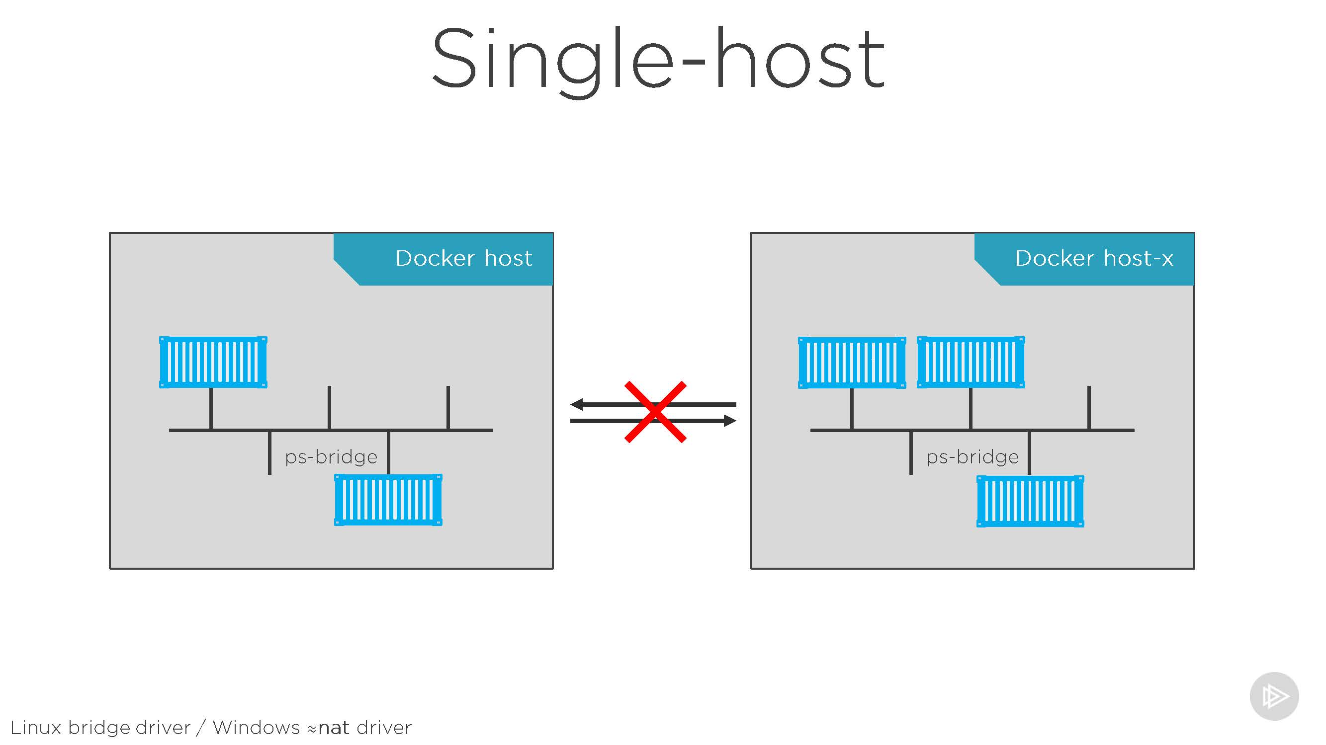
Docker > Networking > Single-host

Slide 31
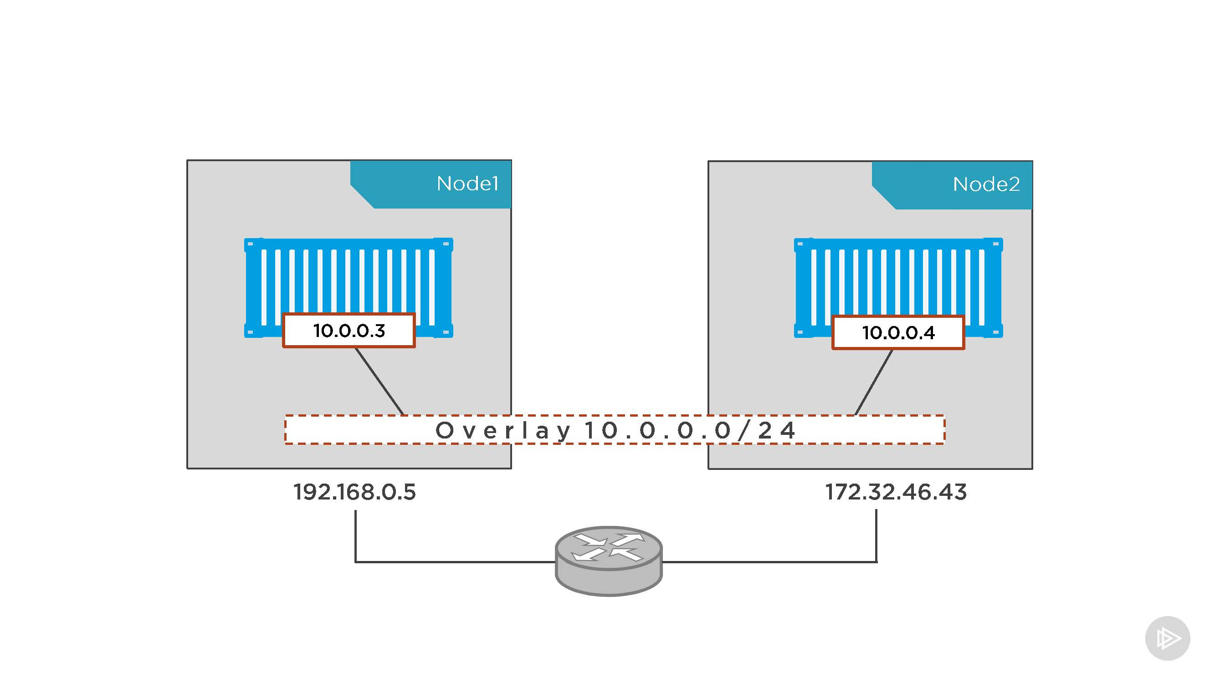
Docker > Networking > Multi-host

Slide 32
Docker > Networking > Hands-on

Slide 33
Docker > Networking > Code Kata #5

Slide 34
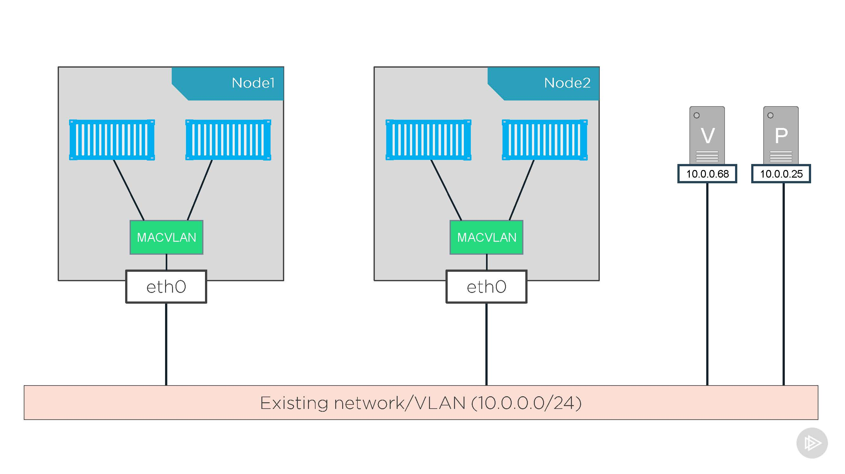
Docker > Networking > MACVLAN

Slide 35
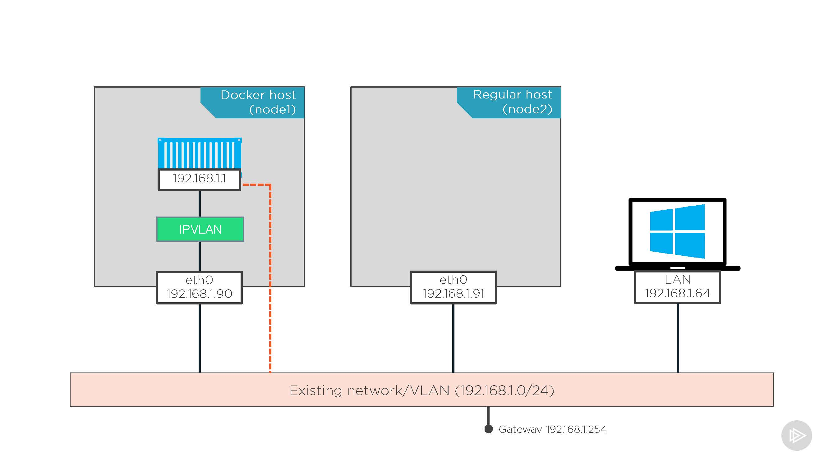
Docker > Networking > IPVLAN

Slide 36
Docker > Networking > Hands-on

Slide 37
Docker > Networking > Code Kata #6

Slide 38
Docker > Networking > Q/A

Slide 39
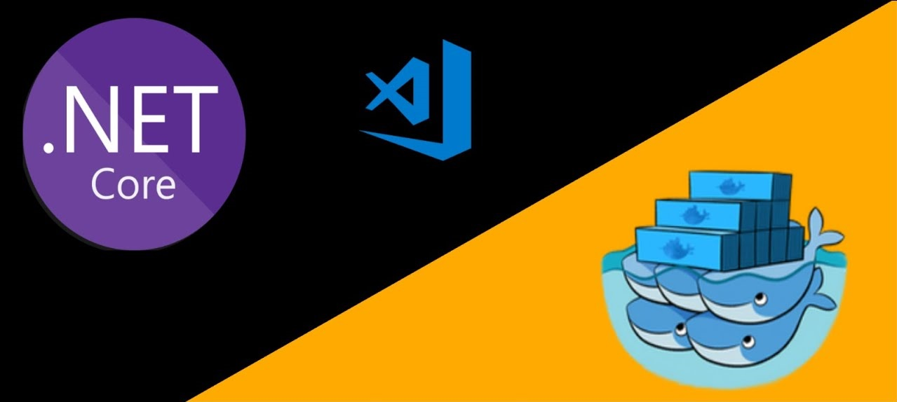
Docker > Development

Slide 40
Docker > Development > Tips & Tricks
”Chaining” CLI operations: docker rm $(docker ps -q -f status=exited)
Clean up local daemon: docker system prune
Execute commands in containers: docker exec {CONTAINER_ID} {COMMAND}
Attach to a running containers: docker attach {CONTAINER_ID}
Listen to docker server events in ”real-time”: docker events
Monitor consumed resources: docker stats
Copy files from host to container: docker cp {HOST_FILE_PATH} {CONTAINER_ID}:{CONTAINER_FILE_PATH}
Keep common instructions at the top of the Dockerfile to utilize the cache.
Chain Your Docker RUN Instructions to Shrink Your Images! RUN wget -O myfile.tar.gz http://example.com/myfile.tar.gz (DONT DO THIS)
RUN tar -xvf myfile.tar.gz -C /usr/src/myapp RUN wget -O myfile.tar.gz http://example.com/myfile.tar.gz \ (DO THIS)
&& tar -xvf myfile.tar.gz -C /usr/src/myapp \
10. Use Docker-Compose

Slide 41
Docker > Development > Tips & Tricks > Demo

Slide 42
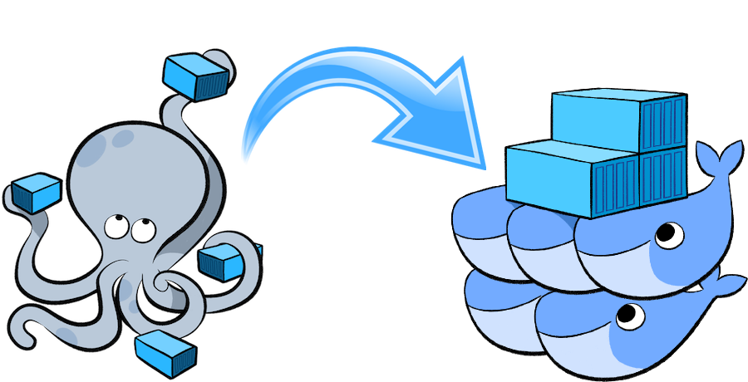
Docker > Development > Docker-Compose

Slide 43
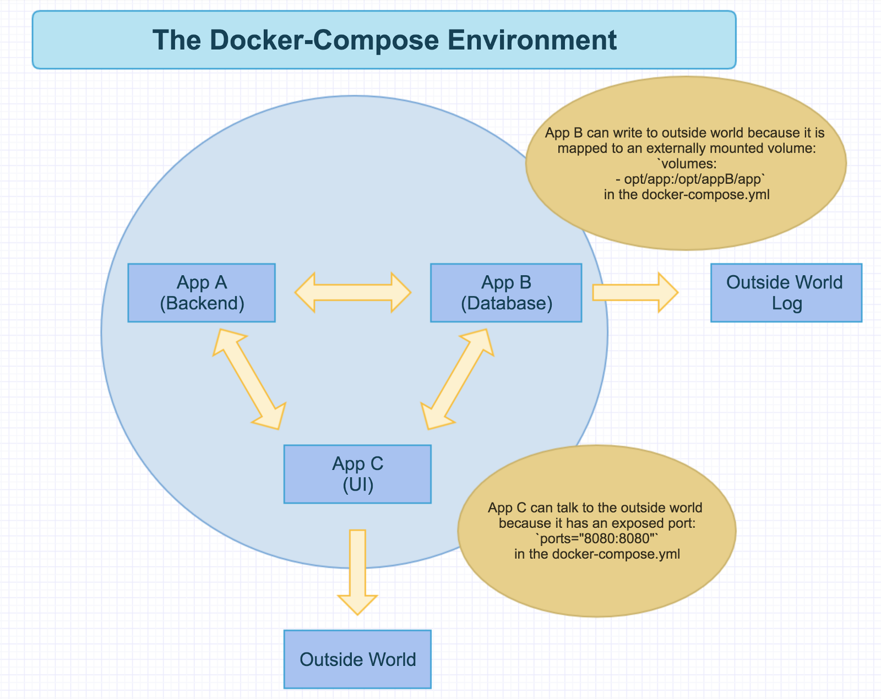
Docker > Development > Docker-Compose > Basics
Provides a yaml-based easy-2-use infrastructure-as-code framework that can easily be migrated to k8s down the line.
Enables safe experimentation on local developer machines.
Images can easily be pushed to peers for review and testing.
Allows multiple isolated environments to exist on a single host.
Works seamlessly accross multiple operating systems.

Slide 44
Docker > Development > Docker-Compose > Example
version: ‘3.4'
services:
blaster.webapi:
hostname: blaster
build:
context: .
dockerfile: src/Blaster.WebApi/Dockerfile
ports:
- "4200:4200"
volumes:
- ./src/Blaster.WebApi/wwwroot:/app/wwwroot
environment:
- "BLASTER_CAPABILITYSERVICE_API_URL=http://capability-service:50900"
- "BLASTER_AWS_JANITOR_API_URL=http://aws-janitor:50901"
- "BLASTER_HARALD_API_URL=http://harald:50902"
- "ASPNETCORE_URLS=http://+:4200"
networks:
development:
hot-reloader:
build:
context: .
dockerfile: src/Dockerfile
volumes:
- ./src/Blaster.WebApi:/app/Blaster.WebApi:rw
networks:
development:
networks:
development:
external: true
Each individual container has its own configuration section where ports, volumes, secrets, networks, etc is mapped
The services section contains all the individual containers that make up our solution
Volumes are often quiet brittle. Make sure you validate your persistence strategy vs your infrastructure storage technologies and use the appropriate plugins (drivers)
Our containers in this sample are mounted on an external network. This enables us to communicate with other containers that are external to this specific solution

Slide 45
Docker > Development > Docker-Compose > Hands-on

Slide 46
Docker > Development > Docker-Compose > Code Kata #7

Slide 47
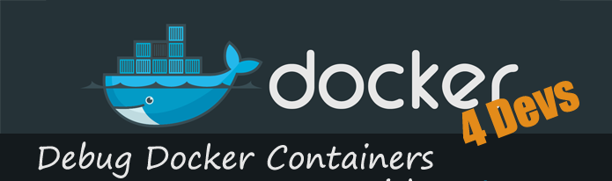
Docker > Development > Debugging containers

Slide 48
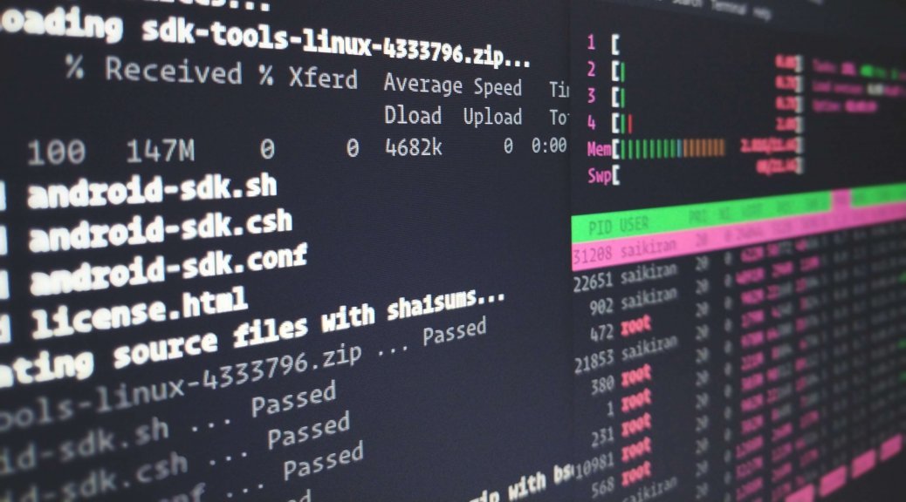
Docker > Development > Debugging containers > CLI
Inspect container to verify its configured as expected
Review container logs
Setup listener for docker events
Listen to container std_out via attach
Review container file system via exec

Slide 49
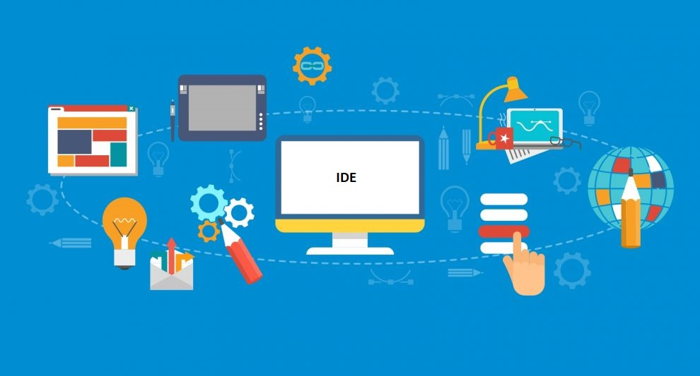
Docker > Development > Debugging containers > IDE
Rider @ https://blog.jetbrains.com/dotnet/2018/07/18/debugging-asp-net-core-apps-local-docker-container/
Visual Studio @ https://techcommunity.microsoft.com/t5/Azure-Developer-Community-Blog/Debugging-Docker-Containers-attaching/ba-p/338698
Visual Studio Code @ https://code.visualstudio.com/blogs/2019/10/31/inspecting-containers

Slide 50
Docker > Development > Hands-on

Slide 51
Docker > Development > Code Kata #8

Slide 52
Docker > Development > Q/A

Slide 53
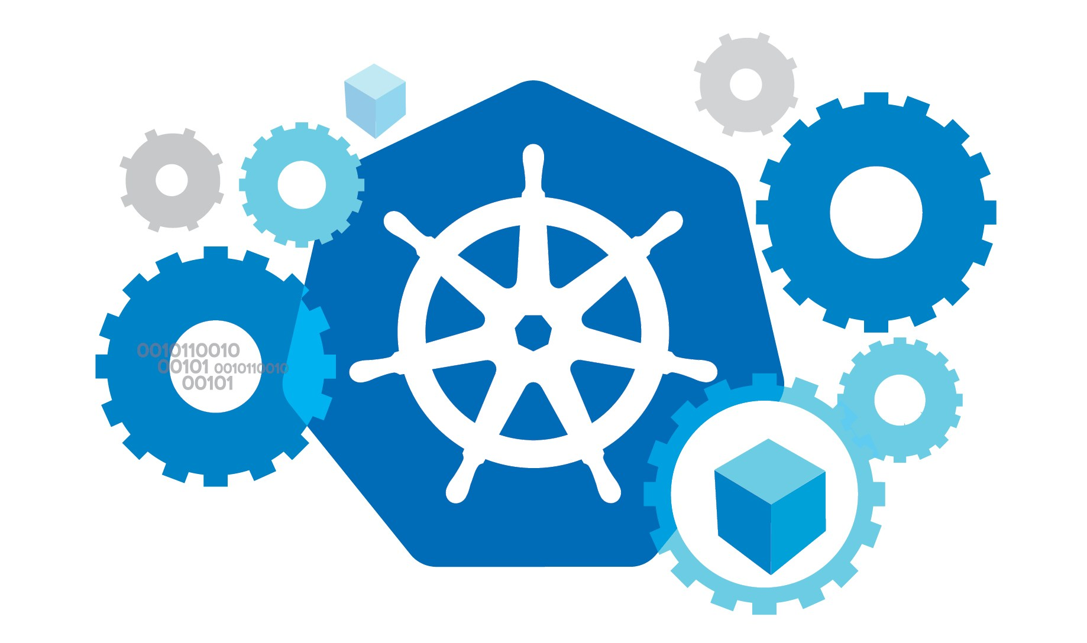
Docker > Orchestration

Slide 54
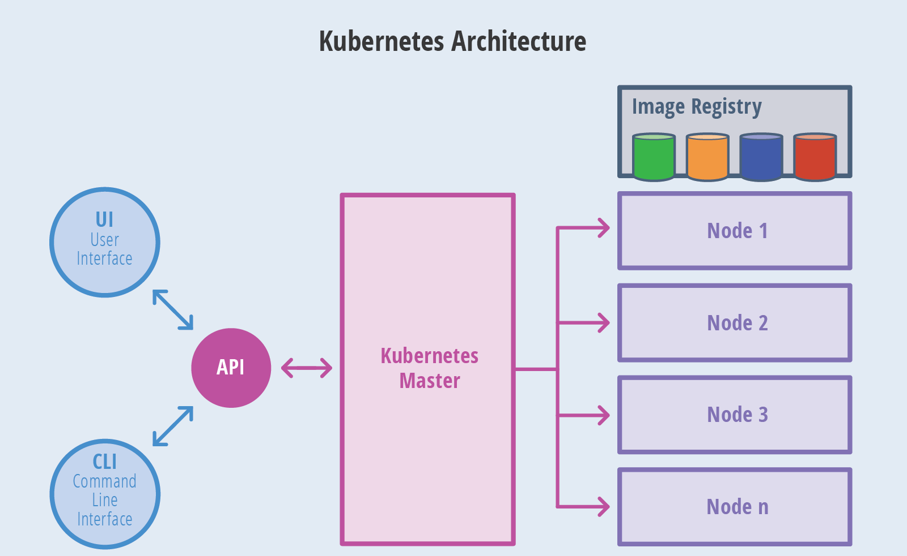
Docker > Orchestration

Slide 55
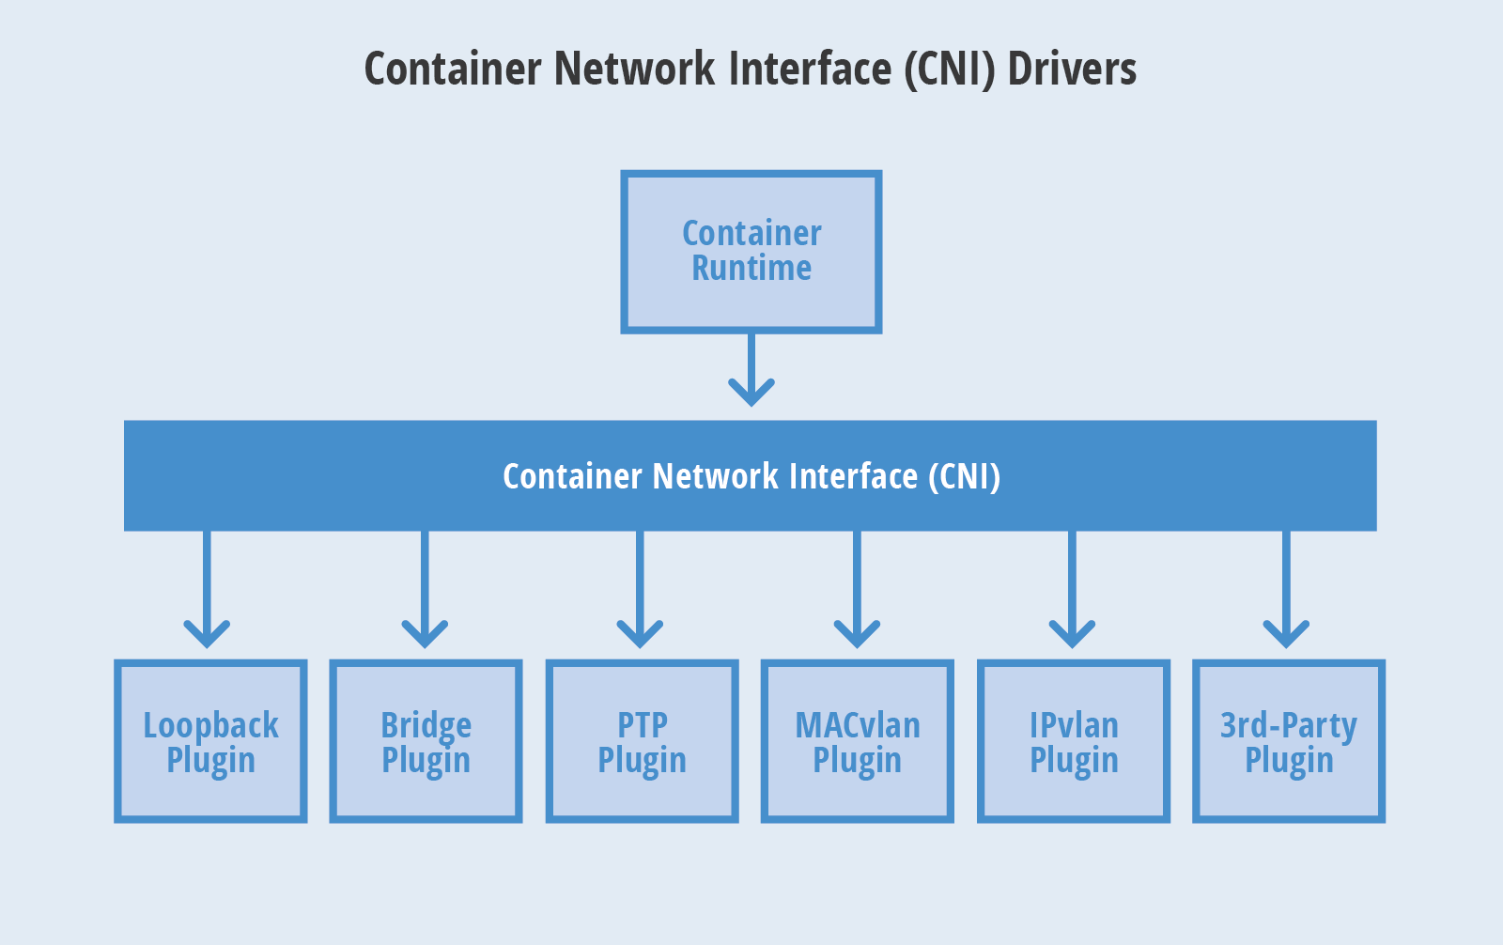
Docker > Orchestration > Container Networking Interface (CoreOS)

Slide 56
Docker > Orchestration > Demo

Slide 57
Docker > Orchestration > Q/A

Slide 58
Docker > Feedback
https://forms.office.com/Pages/ResponsePage.aspx?id=ZpSpcwWtIUKfkOcUKqL2wTFclz-gNvpNq3THAj1j3ZxUODk1TjlEWVNJNzUxNjAwTFhGQkQ2VkNTWi4u

Slide 59
Docker > Literature
https://docker.com
https://docs.microsoft.com/en-us/visualstudio/docker/tutorials/docker-tutorial
https://www.cio.com/article/2924995/what-are-containers-and-why-do-you-need-them.html

